Slide 1
WPF Containers

Slide 2
Agenda
Absolute position: Canvas
Stacking:
StackPanel, WrapPanel, DockPanel
First in first out
Proportion or row / column:
Grid, UniformGrid

Slide 3

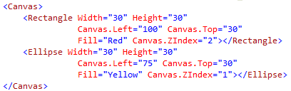

Canvas
Index: Canvas.ZIndex. Bigger number on top
Attached properties
Quiz:

Slide 4
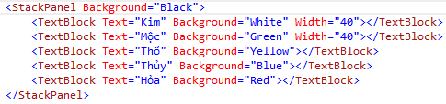
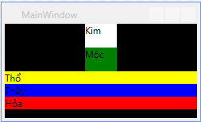
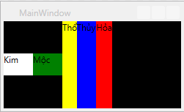
StackPanel
Default: Orientation=“Vertical”
Orientation=“Horizontal”

Slide 5
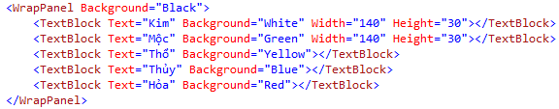
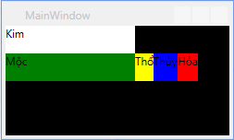
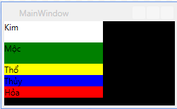
WrapPanel
Orientation=“Vertical”
Mặc định: Orientation=“Horizontal”

Slide 6
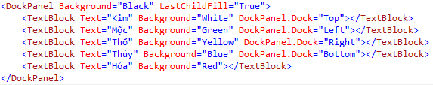
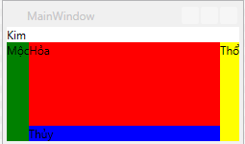
DockPanel
Relative position won’t change
LastChildFill

Slide 7
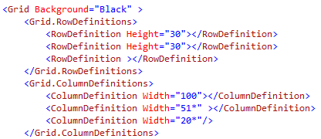
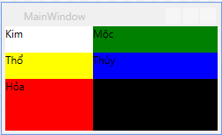
Grid
Table like
Must define columns and rows first

Slide 8

Grid order

Slide 9
Some characteristics of grid
If there is 1 child: auto fill up
If there is n child: last child will overlap previous childs
Specified width / height will lead to horizontal / vertical alignment

Slide 10
Auto vs *
Auto: size itself based on its content

Slide 11
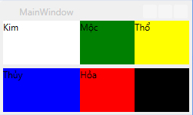
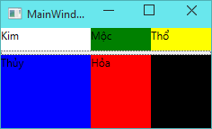
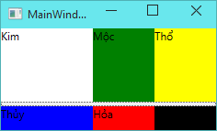
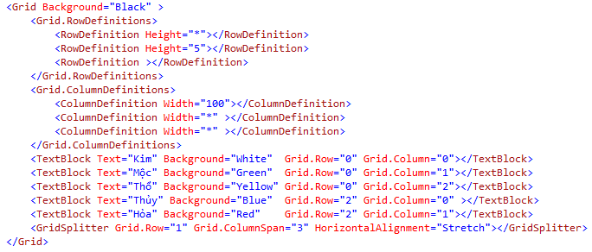
GridSplitter
Allow manually adjusted

Slide 12
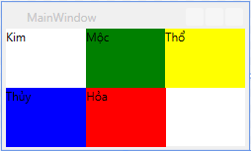
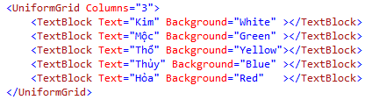
UniformGrid
Same dimensions for all childs
Automatically adjust
FlowDirection: LeftToRight, RightToLeft

Slide 13
Tips – Auto size
HorizontalAlignment="Stretch“
VerticalAlignment="Stretch"

Slide 14
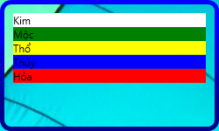
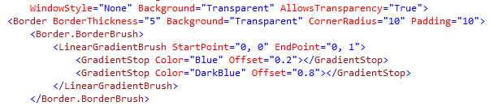
Border
Contains only one child
Some important attributes
BorderBrush
BorderThickness
CornerRadius

Slide 15
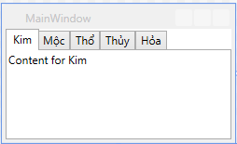
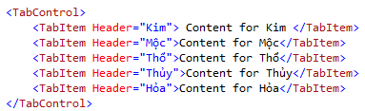
TabControl
Used to switch between pages

Slide 16
UserControl
A control with customized layout

Slide 17
PageNavigation
Use Page instead of Window

Slide 18
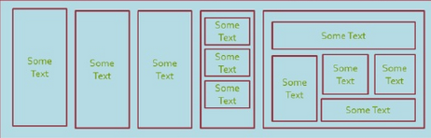
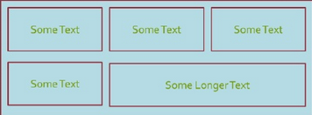
Inclass excersise
Write xaml code to create UI nearly like the image (80%)
Hint: there are a lot of solutions
100
300
1
400
100
200
200
2
400

Slide 19
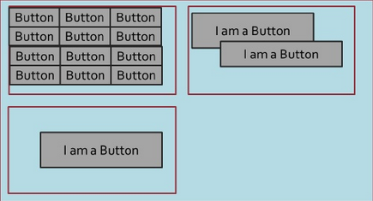
Exercises (cont)
60
200
30
3
300
100

Slide 20
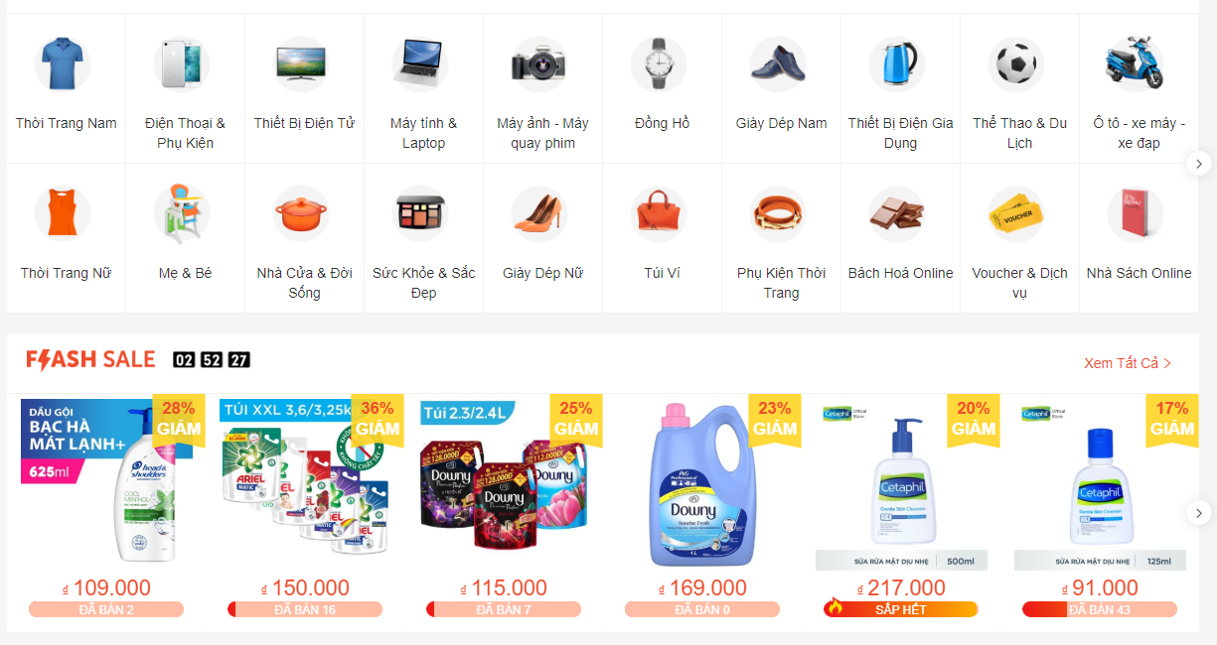
Homework 1 - Shopee

Slide 21

Homework 2 - tiki

Slide 22
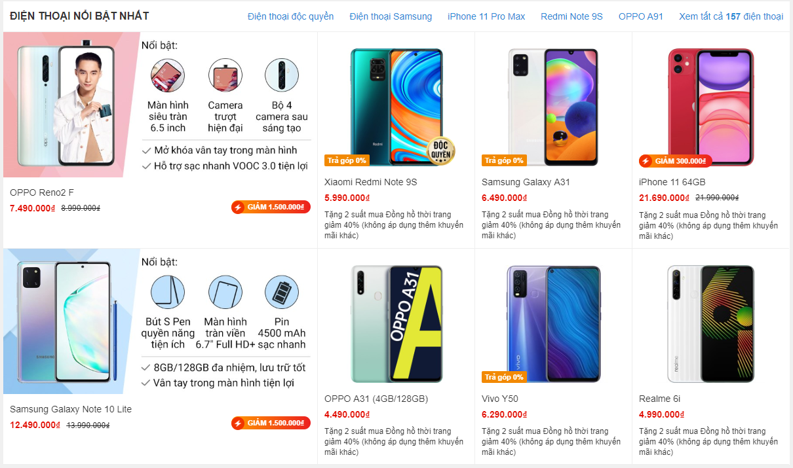
Homework 3 - tgdd

Slide 23
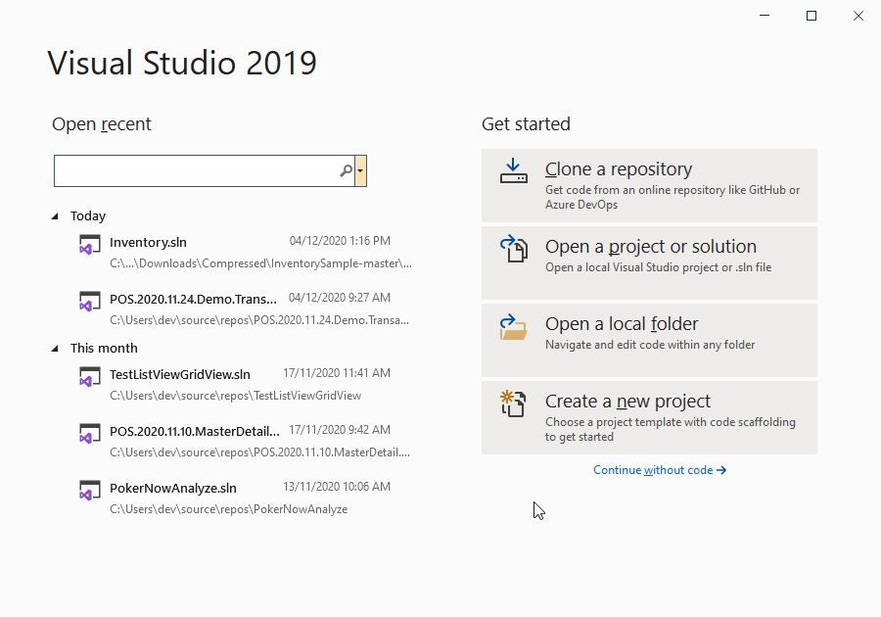
Homework 4

Slide 24
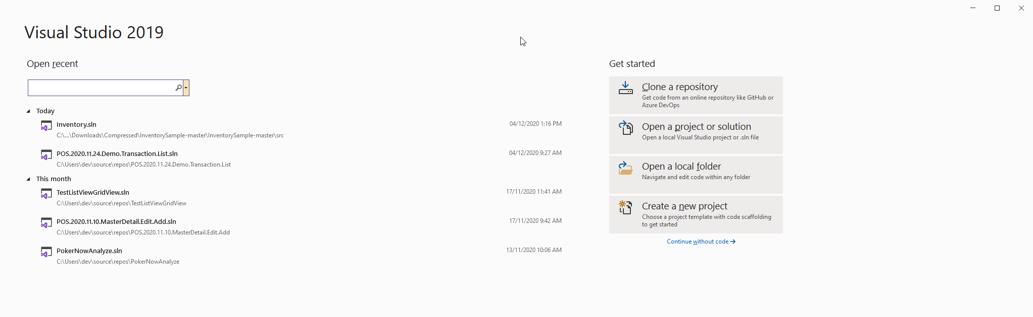
Some thing to notice
We could use two column, the left use MaxWidth, the right is left aligned

Slide 25
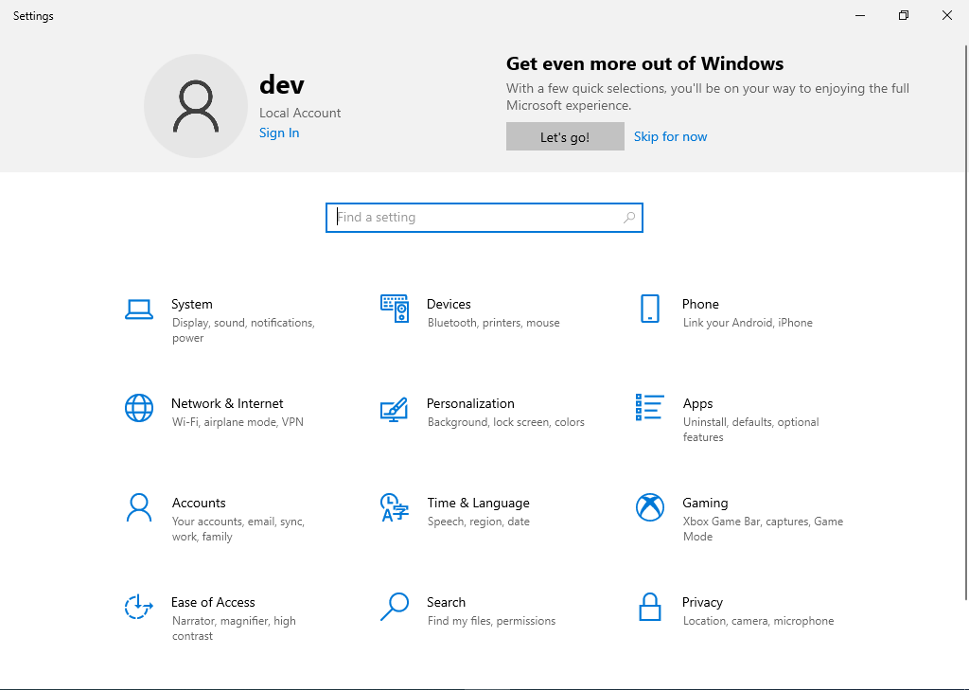
Homework 5

Slide 26
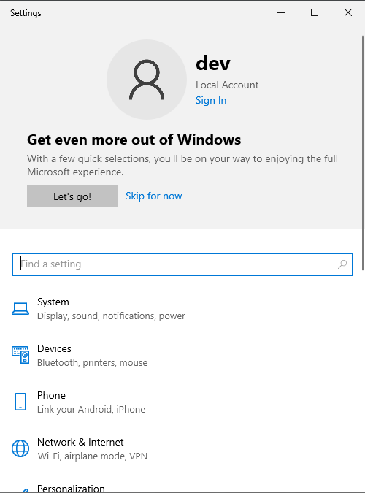
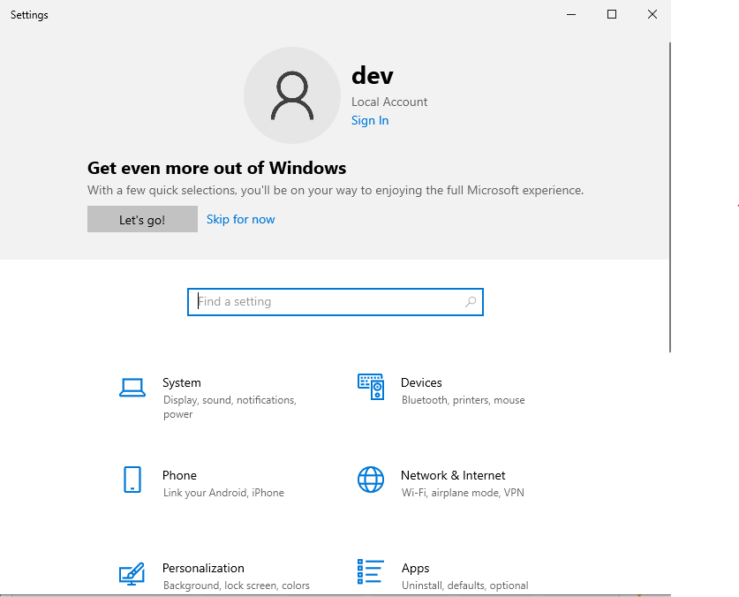
Things to consider - Responsive & Adaptive

Slide 27
Solution
Trigger

Slide 28
Modern UI solution?
WinUI vs WPF

Slide 29
NavigationView

